Slide 1
INTRODUCTION TO
DATA ANALYTICS

Slide 2
What is Data Analytics?
Process that turns data into knowledge, insights and actions that improves decision making
In other words it is deriving intelligence out of data
Involves data collection, transformation, analysis and reporting
Data Analytics helps us:
To understand our world better
To make better decisions
To optimize processes

Slide 3
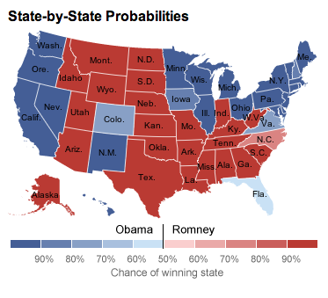

Predicting who is going to be the next US President
http://fivethirtyeight.com/
Notes:
Nate Silver. In the last two US Presidential elections, he correctly predicted 99 out of 100 states. Started off as a data analyst in sports. In 2009, was named one of The World’s most influential people by Time magazine

Slide 4
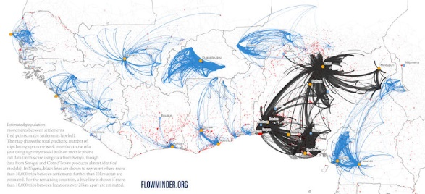
Predicting where Ebola is going to strike next
http://www.worldpop.org.uk/ebola/
Notes:
This map (part of west Africa) was drawn based on cell-phone communications. Using cell-phone usage data, researchers were able to accurately predict where the population was migrating and by studying the migrating pattern they were able to predict very accurately where and when Ebola would strike

Slide 5
Some practical cases
Targeted customer marketing
Optimizing stock management in manufacturing by predicting demand
Product affinity analysis in retailing
Attrition management
Improving customer retention
Text mining to gather feedback
Finding potential candidate molecules that can be developed into drugs
Prediction of revenue for a planned new store

Slide 6
Types of Analysis
Data
Analytics
Descriptive
What happened?
Diagnostic
Why did it happen?
Predictive
What will happen?
Prescriptive
What should I do?

Slide 7
Steps in Data Analysis Process
Start with an interesting question
Collect data
Clean and Explore the data
Create data models
Interpret and Communicate the results

Slide 8
Job Titles
Analyst
Big Data Analyst
Business Analyst
Consultant
Data Analyst
Data Modeler
Data Scientist
Decision Scientist
Machine Learning Specialist
Notes:
Machine Learning is not something very different from Data Analytics. Machine Learning focuses on building algorithms using some of the tools we are going to study in this course. For example, when facebook recognizes your friends in the photo you uploaded, it is essentially using a machine learning algorithm

Slide 9
Who is a data scientist?
Someone who knows more statistics than a computer scientist and more computer science than a statistician
- Joshua Blumenstock
Notes:
Little bit of mathematical aptitude and some amount of programming skills is all that is needed to become a data scientist

Slide 10
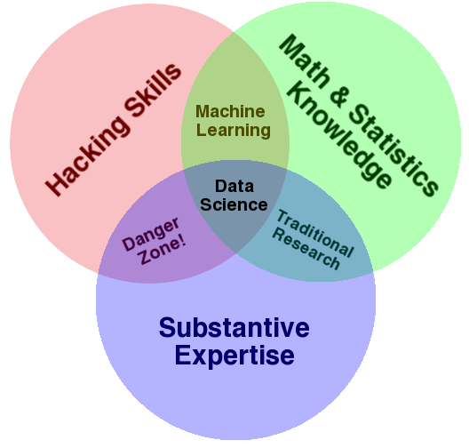
Skills required
http://drewconway.com/zia/2013/3/26/the-data-science-venn-diagram
Notes:
Drew Conway

Slide 11
Skills required
Know how to analyse data and create data visualizations
Experience with any statistical programming language (R, Python etc.)
Experience in database querying languages (like SQL or MySQL)
A good understanding of machine learning tools and techniques
A good understanding of statistics (Hypothesis Testing, Summary Statistics etc.)
Understanding of data wrangling / data munging
Familiarity with big data tools (Hive, Pig etc.)

Slide 12
NICHE areas in Data Analytics
Social Media Analytics
Marketing Analytics
Customer Analytics
Supply Chain Analytics
Demand Forecasting
HR Analytics
Risk Analytics
Web Analytics

Slide 13
Tools used in Data Analytics
R
SAS
Python
MATLAB
STATA
SPSS
Julia
…

Slide 14
Why R?
Most comprehensive statistical analysis package
Free and open source software
Most popular data analysis tool
More then 5000 packages (libraries) available
Cross-platform capability
Active user groups
Disadvantages
Memory Limitation

Slide 15
Supervised Learning
Variables under study can be split into 2 groups: explanatory variables and dependent variables
Target is to specify a relationship between these two variables
The relationship is obtained by analysing the training data
Example: Prediction of revenue for a planned new store
Explanatory variables: Store size, Location etc.
Dependent variable: Revenue
Training Data: Data from existing stores

Slide 16
Unsupervised Learning
No distinct dependent variable
All variables are treated the same way
Target is to find patterns in data
Example: Segmenting customers into distinct groups

Slide 17
Exercise
Classify whether the following problems as supervised or unsupervised:
Predicting future stock market prices
Identifying major topics people are tweeting about
Classifying a tumour as either malignant or non-malignant
Detecting spam in email
Identifying groups of houses according to their house type, value and location

